Slide 1
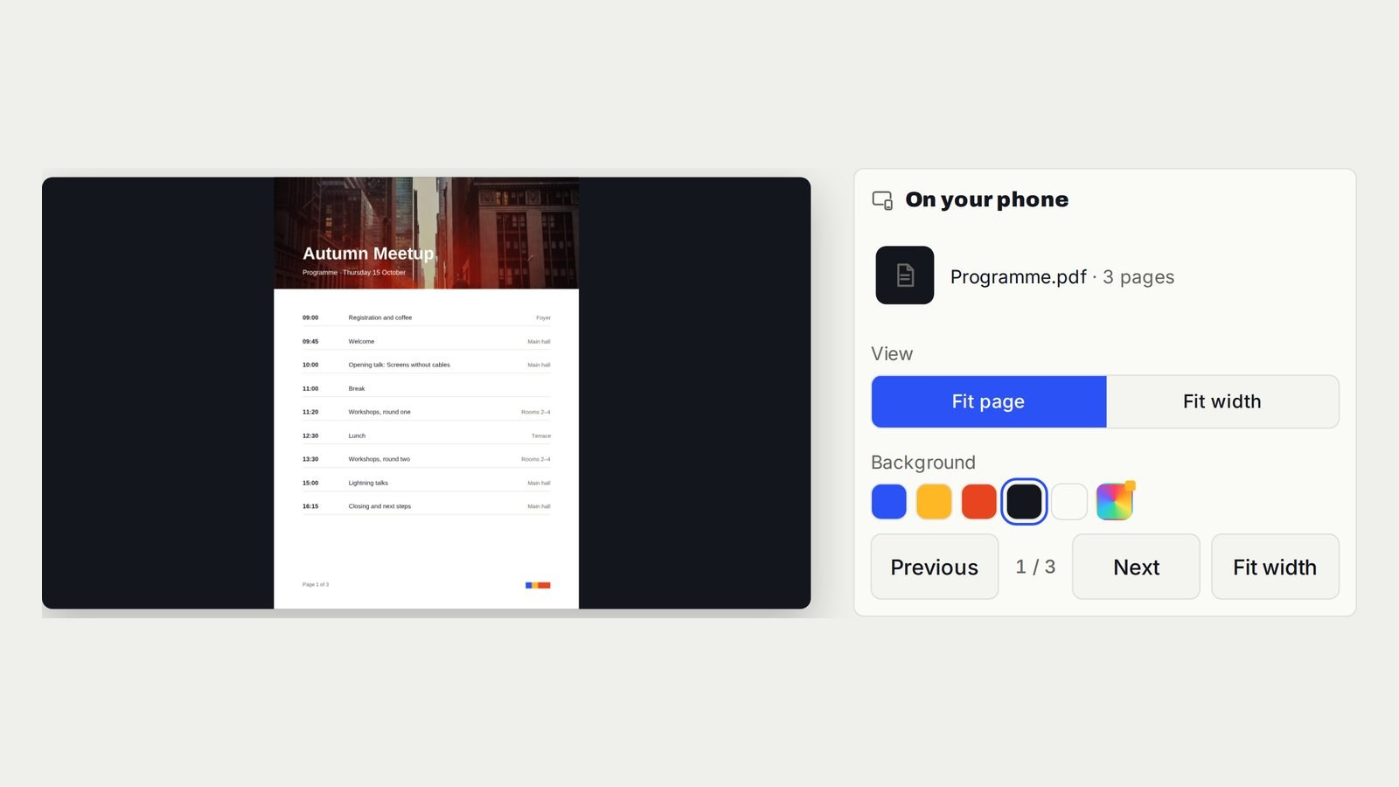
V U THIS / SCREEN WALKTHROUGHS
PDF on TV or a projector
Your phone turns the pages. The room sees the PDF.
Open vuthis.com on the screen to get going.
https://vuthis.com/display-pdf-on-tv
01 / 08
Notes:
V U This. PDF and projector walkthrough. Source: https://vuthis.com/display-pdf-on-tv. Reused campaign illustration: week1/images/article-documents-1600x900.jpg

Slide 2
V U THIS / SCREEN WALKTHROUGHS
A browser page connects the screen
1. Open vuthis.com in the screen's browser.
2. Scan its QR code with your phone, or enter the code at vuthis.com/r on a laptop.
3. Choose what to show and tap Show now.
https://vuthis.com/r
02 / 08
Notes:
V U This. Laptop or tablet controller. Source: https://vuthis.com/r. Native editable text.

Slide 3
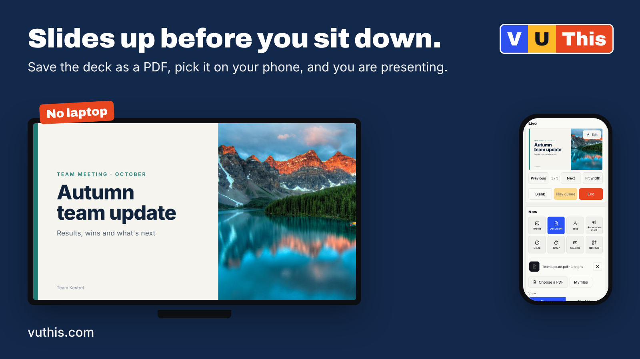
V U THIS / SCREEN WALKTHROUGHS
PowerPoint slides on TV
Save the deck as a PDF. Choose Document, select the file and tap Show now.
Next and Previous on your phone turn the slides. The same PDF route works for Keynote and Google Slides.
https://vuthis.com/display-pdf-on-tv
03 / 08
Notes:
V U This. PowerPoint and PDF instructions. Source: https://vuthis.com/display-pdf-on-tv. Reused campaign illustration: week1/images/new/new-do-b-1600x900.png

Slide 4
V U THIS / SCREEN WALKTHROUGHS
A projector uses the same workflow
Open vuthis.com in the projector browser, or in a browser on the computer already driving the projector.
Connect your phone and select the PDF. Fit page shows the complete slide. Fit width makes a tall document easier to read.
https://vuthis.com/display-pdf-on-tv
04 / 08
Notes:
V U This. Phone-to-projector instructions. Source: https://vuthis.com/display-pdf-on-tv. Native editable text.

Slide 5
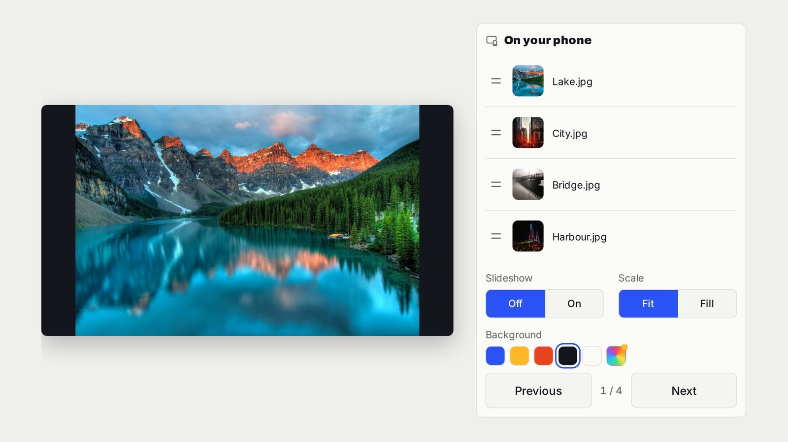
V U THIS / SCREEN WALKTHROUGHS
Photos on TV from your phone
Choose the photos. Tap Show now.
Turn Slideshow on for automatic changes. Fit keeps the whole picture visible. Fill uses the screen edge to edge.
Your other phone activity stays on your phone.
https://vuthis.com/show-photos-on-tv
05 / 08
Notes:
V U This. Photo slideshow walkthrough. Source: https://vuthis.com/show-photos-on-tv. Reused campaign illustration: week1/images/article-photos-1600x900.jpg

Slide 6
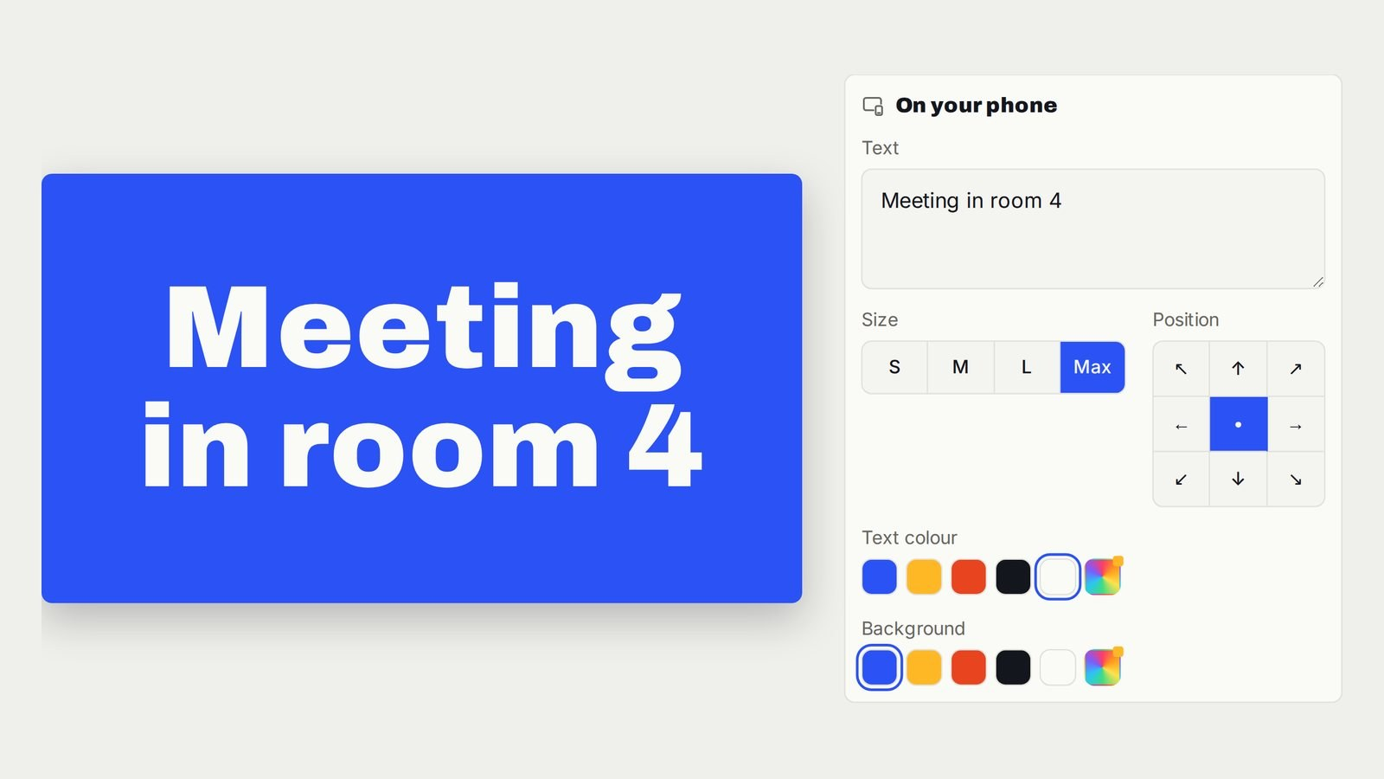
V U THIS / SCREEN WALKTHROUGHS
A message everyone can read
Choose Text, write the message and show it.
A welcome, a room change or the next instruction appears on the shared screen. Update the words from the controller when plans change.
https://vuthis.com/large-text-display
06 / 08
Notes:
V U This. Large text instructions. Source: https://vuthis.com/large-text-display. Reused campaign illustration: week1/images/article-largetext-1600x900.jpg

Slide 7
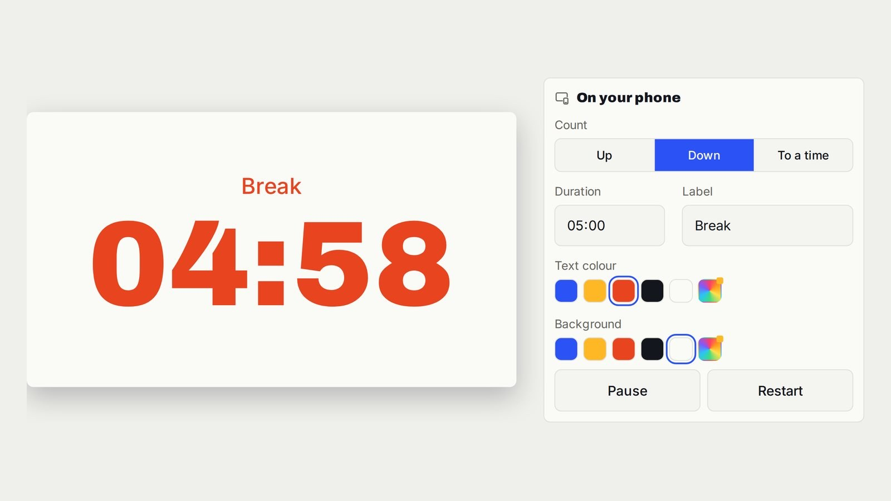
V U THIS / SCREEN WALKTHROUGHS
A timer you control from your seat
Choose Timer, set the duration and add a label. Tap Show now.
Pause or restart from your phone while the room sees the time. Useful for a workshop, presentation or break.
https://vuthis.com/full-screen-countdown-timer
07 / 08
Notes:
V U This. TV and projector timer guide. Source: https://vuthis.com/full-screen-countdown-timer. Reused campaign illustration: week1/images/article-timer-1600x900.jpg

Slide 8
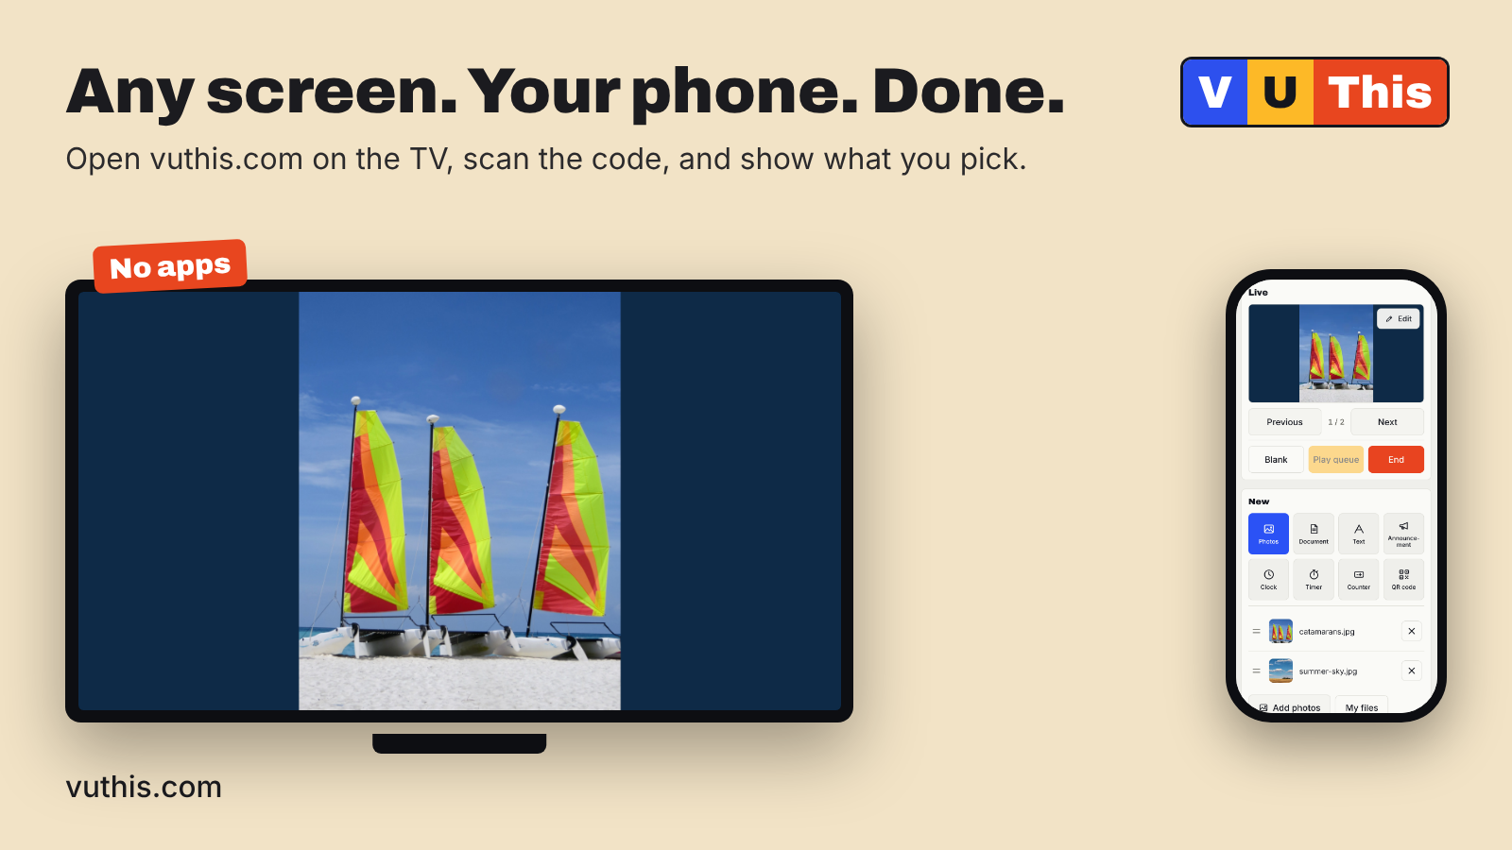
V U THIS / SCREEN WALKTHROUGHS
The next screen starts at vuthis.com
No apps. No HDMI from your controlling device. No shared Wi-Fi needed.
Open vuthis.com on the display. Connect from your phone, laptop or tablet. Show what the room needs.
Keep the instructions for the next meeting, class or family slideshow.
https://vuthis.com
08 / 08
Notes:
V U This. Open V U This. Source: https://vuthis.com. Reused campaign illustration: week1/images/new/new-vu-a-1600x900.png

